Slide 1
WRES2203 Advanced Network Technology
Chapter 1
Introduction to Scaling Networks

Slide 2
Contents
Introduction
Hierarchical Network Design
Enterprise Architecture
Expanding the Network
Selecting Network Devices

Slide 3
Introduction
Network designers must design and build an enterprise network that is scalable and highly available.
Networks must meet the current needs of organizations and be able to support emerging technologies as new technologies are adopted.
Network design principles and models can help a network engineer design and build a network that is flexible, resilient, and manageable.

Slide 4
Hierarchical Network Design
The network that is used to support the business enterprise is called an enterprise network.
An enterprise network must support the exchange of various types of network traffic, including data files, email, IP telephony, and video applications for multiple business units.
Users expect enterprise networks to be up 99.999 percent of the time.
Network can be categorized into:
  Small network - Up to 200 devices.
  Medium-sized network - 200 to 1000 devices.
  Large network - 1000+ devices.

Slide 5
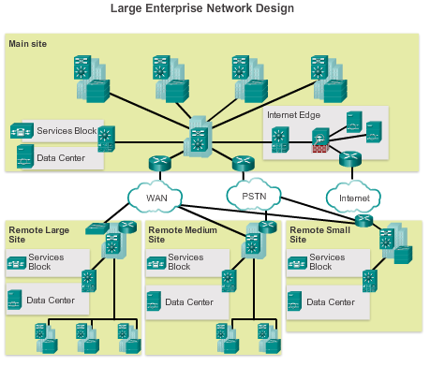
Hierarchical Network Design

Slide 6
Hierarchical Network Design
Hierarchical Network Design divides the network functionality into three distinct layers:
  Access Layer
    Provides workgroup/user access to the network.
  Distribution Layer
    Provides policy-based connectivity and controls the boundary between the access and core layers.
  Core Layer
    Provides fast transport between distribution switches within the enterprise campus.

Slide 7
Hierarchical Network Design
Access Layer
  Layer 2 switching
  High availability
  Port security
  QoS classification and marking and trust boundaries
  Address Resolution Protocol (ARP) inspection
  Access Control Lists (ACLs)
  Spanning tree
  Power over Ethernet (PoE) and auxiliary VLANs for VoIP

Slide 8
Hierarchical Network Design
Distribution Layer
  Aggregation of LAN or WAN links
  Policy-based security in the form of access control lists (ACLs) and filtering
  Routing services between LANs and VLANs and between routing domains (e.g., EIGRP to OSPF)
  Redundancy and load balancing
  A boundary for route aggregation and summarization
  Broadcast domain control

Slide 9
Hierarchical Network Design
Core Layer
  Providing high-speed switching (i.e., fast transport)
  Providing reliability and fault tolerance
  Scaling by using faster equipment

Slide 10
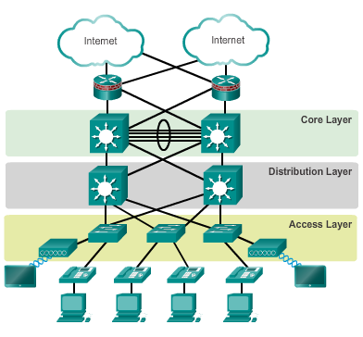
Hierarchical Network Design

Slide 11
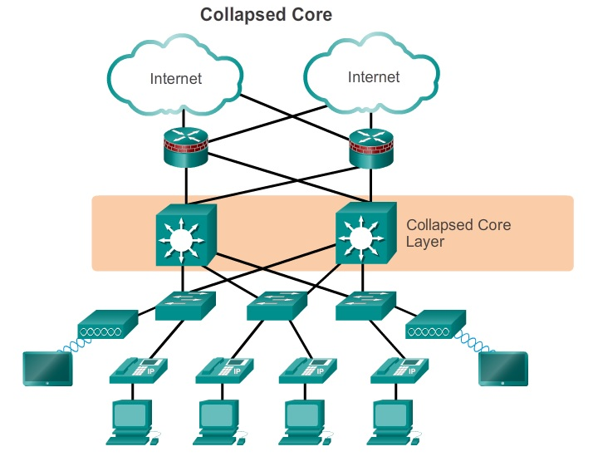
Hierarchical Network Design
Many small enterprise networks use a two-tier hierarchical design where the core and distribution layers are collapsed into one layer.

Slide 12
Enterprise Architecture
A modular network design separates the network into various functional network modules, each targeting a specific place or purpose in the network.
Modular Design
  Simpler problem detection and higher overall system availability.
  Greater flexibility in the maintenance and operation of the campus network.
  Specific module can be updated or replaced.
  Security can be implemented on a modular basis allowing for more granular security control.

Slide 13
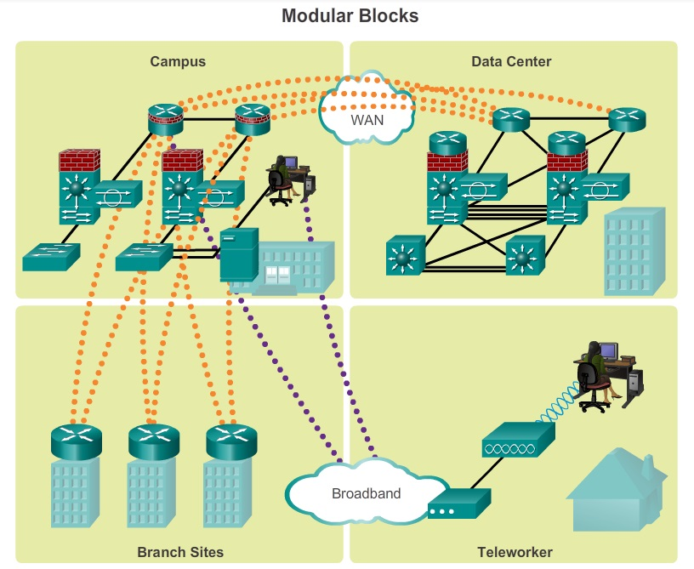
Enterprise Architecture

Slide 14
Enterprise Architecture
The Cisco Enterprise Architecture model separates the enterprise network into functional areas.
The modularity that is built into the architecture allows flexibility in network design and facilitates implementation and troubleshooting.
Modules:
  Enterprise Campus
  Enterprise Edge
  Service Provider Edge
  Enterprise Data Center
  Enterprise Branch
  Enterprise Teleworker

Slide 15
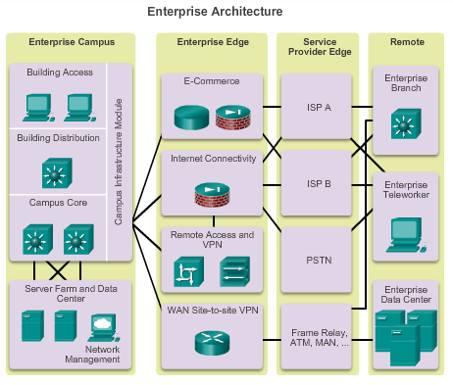
Enterprise Architecture

Slide 16
Enterprise Architecture
Campus Network
  A building or group of buildings connected into one enterprise network that consists of many LANs.
  A campus is generally limited to a fixed geographic area, but it can span several neighboring buildings, for example, an industrial complex or business park environment.
  It consists of the following sub-modules:
    Building access
    Building distribution
    Campus core
    Data center

Slide 17
Enterprise Architecture
Enterprise Edge
  Provides connectivity for voice, video, and data services outside the enterprise.
  It consists of the following sub-modules:
    E-commerce networks and servers
    Internet connectivity and Demilitarized Zone (DMZ)
      Secure connectivity to Internet services such as public servers, email, and DNS.
    Remote Access and VPN
    WAN
      Routing traffic between remote sites and the central site.

Slide 18
Enterprise Architecture
Service Provider Edge
  To link to other sites.
  It consists of the following sub-modules:
    Internet Service Providers (ISPs)
      Single-homed
      Dual-homed
      Multihomed
      Dual-multihomed
    WAN services such as Frame Relay, ATM, and MAN
    Public Switched Telephone Network (PSTN) services

Slide 19
Enterprise Architecture
Enterprise Branch
  Includes remote branches that allow employees to work at non-campus locations.
  These locations are typically responsible for providing security, telephony, and mobility options to employees, as well as general connectivity into the campus network and the different components located inside the enterprise campus.
  The enterprise branch module allows enterprises to extend head-office applications and services, such as security, Cisco Unified Communications, and advanced application performance, to the remote branches.

Slide 20
Enterprise Architecture
Enterprise Teleworker
  The module is responsible for providing connectivity for workers who operate out of different geographically dispersed locations, including home offices, hotels or customer/client sites.
  The mobile users connect to the Internet using the services of a local ISP, such as cable modem or DSL.
  VPN services can then be used to secure communications between the mobile worker and central campus.

Slide 21
Enterprise Architecture
Enterprise Data Center
  A data center with all of the same functional options as a campus data center, but exists at a remote location.
  This provides an added layer of security as the offsite data center can provide disaster recovery and business continuance services for the enterprise.

Slide 22
Expanding the Network
For many organizations, the availability of the network is essential to supporting business needs.
Redundancy is an important part of network design for preventing disruption of network services by minimizing the possibility of a single point of failure.
One method of implementing redundancy is by installing duplicate equipment and providing failover services for critical devices.

Slide 23
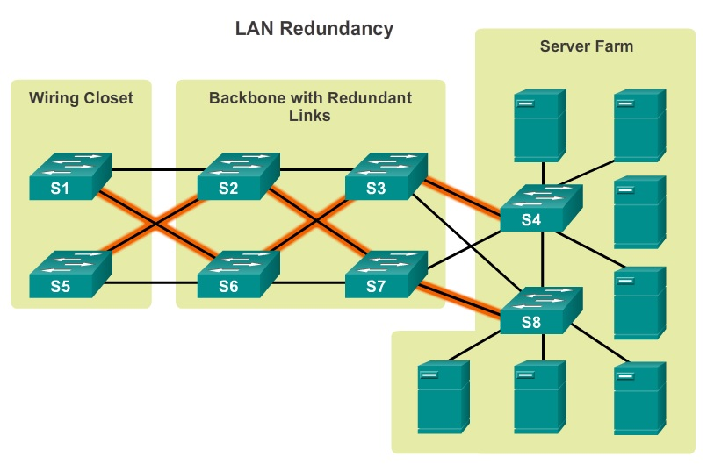
Expanding the Network

Slide 24
Expanding the Network
In hierarchical network design, some links between access and distribution switches may need to process a greater amount of traffic than other links.
As traffic from multiple links converges onto a single, outgoing link, it is possible for that link to become a bottleneck.
Link aggregation allows an administrator to increase the amount of bandwidth between devices by creating one logical link made up of several physical links. EtherChannel is a form of link aggregation used in switched networks.

Slide 25
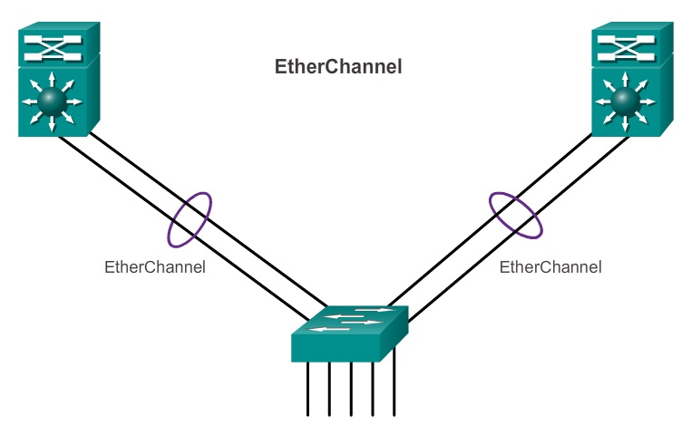
Expanding the Network

Slide 26
Expanding the Network
The network must be designed to be able to expand network access to individuals and devices, as needed.
An increasingly important aspect of extending access layer connectivity is through wireless connectivity.
Providing wireless connectivity offers many advantages, such as increased flexibility, reduced costs, and the ability to grow and adapt to changing network and business requirements.

Slide 27
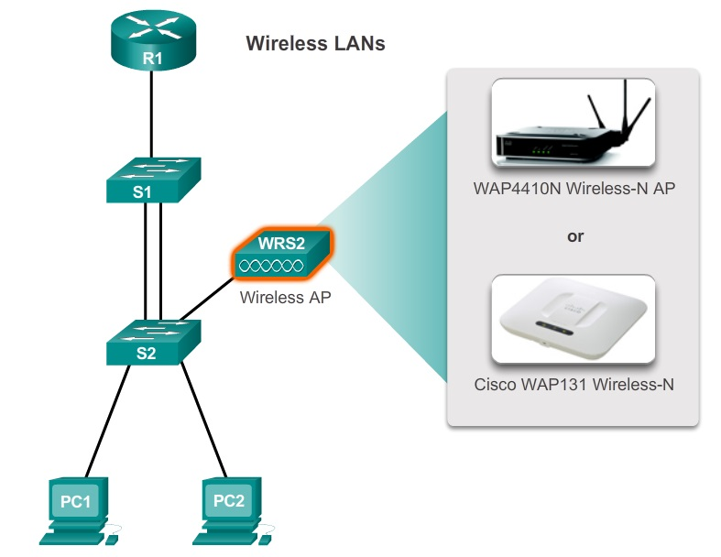
Expanding the Network

Slide 28
Expanding the Network
Link-state routing protocols such as Open Shortest Path First (OSPF) works well for larger hierarchical networks where fast convergence is important.
Another popular routing protocol for larger networks is Enhanced Interior Gateway Routing Protocol (EIGRP).
EIGRP uses multiple tables to manage the routing process. EIGRP contains many features that are not found in any other routing protocols. It is an excellent choice for large, multi-protocol networks that employ primarily Cisco devices.

Slide 29
Selecting Network Devices
When designing a network, it is important to select the proper hardware to meet current network requirements, as well as allow for network growth.
Five categories of switches for enterprise networks
  Campus LAN Switches
    To scale network performance in an enterprise LAN, the switch platforms include the Cisco 2960, 3560, 3750, 3850, 4500, 6500, and 6800 Series.
  Cloud-Managed Switches
    Enable virtual stacking of switches. They monitor and configure thousands of switch ports over the web, without the intervention of onsite IT staff.

Slide 30
Selecting Network Devices
  Data Center Switches
    Switches that can promote infrastructure scalability, operational continuity, and transport flexibility.
    The data center switch platforms include the Cisco Nexus Series switches and the Cisco Catalyst 6500 Series switches.
  Service Provider Switches
    Aggregation switches are carrier-grade Ethernet switches that aggregate traffic at the edge of a network.
    Service provider Ethernet access switches feature application intelligence, unified services, virtualization, integrated security, and simplified management.

Slide 31
Selecting Network Devices
  Virtual Networking
    Provide secure multi-tenant services by adding virtualization intelligence technology to the data center network.
When selecting switches, network administrators must determine the switch form factors. This includes fixed configuration, modular configuration, stackable or non-stackable.

Slide 32
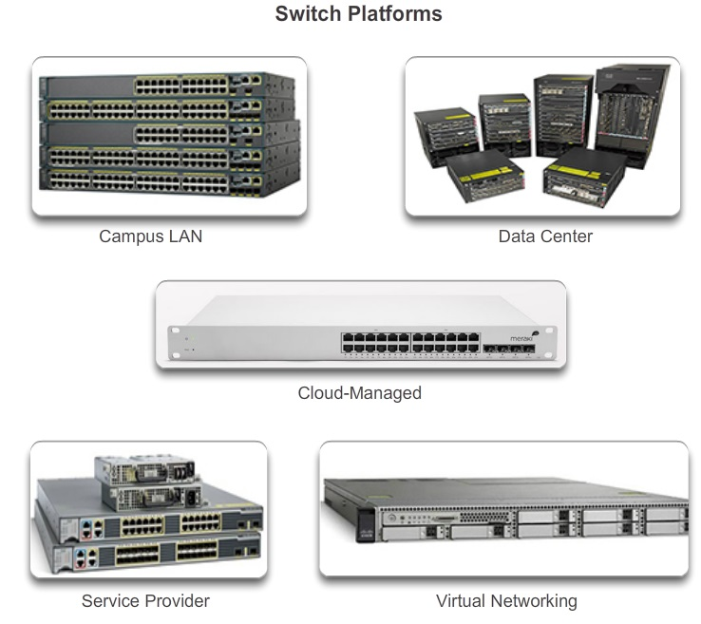
Selecting Network Devices

Slide 33
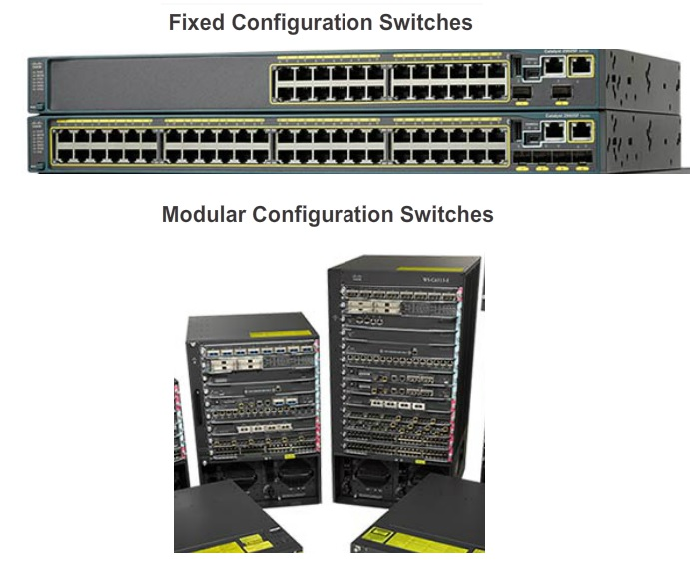
Selecting Network Devices

Slide 34
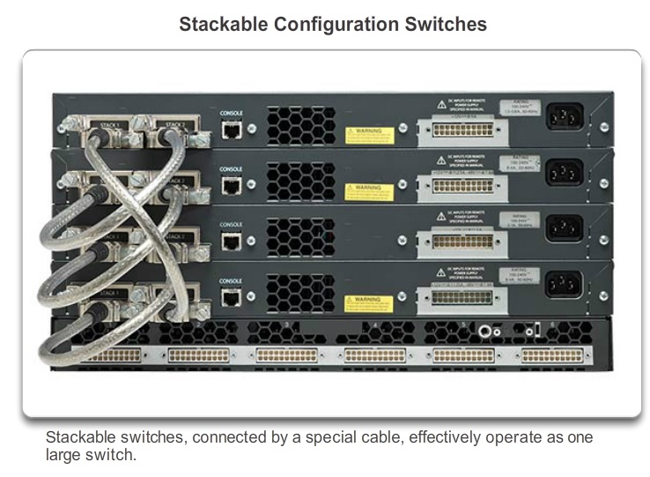
Selecting Network Devices

Slide 35
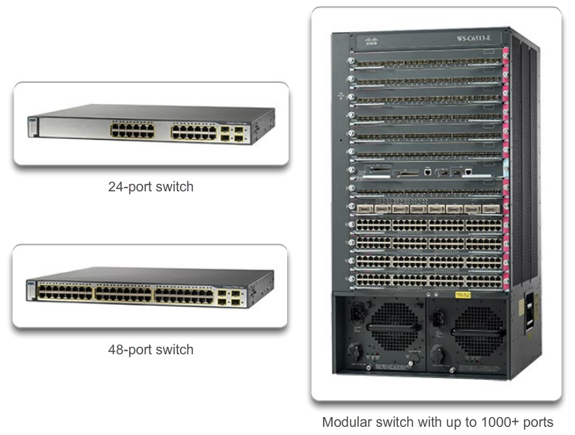
Selecting Network Devices
The port density of a switch refers to the number of ports available on a single switch.

Slide 36
Selecting Network Devices
Forwarding rates define the processing capabilities of a switch by rating how much data the switch can process per second.
Forwarding rates are important to consider when selecting a switch. If the switch forwarding rate is too low, it cannot accommodate full wire-speed communication across all of its switch ports.
Wire speed is the data rate that each Ethernet port on the switch is capable of attaining. Data rates can be 100 Mb/s, 1 Gb/s, 10 Gb/s, or 100 Gb/s.

Slide 37
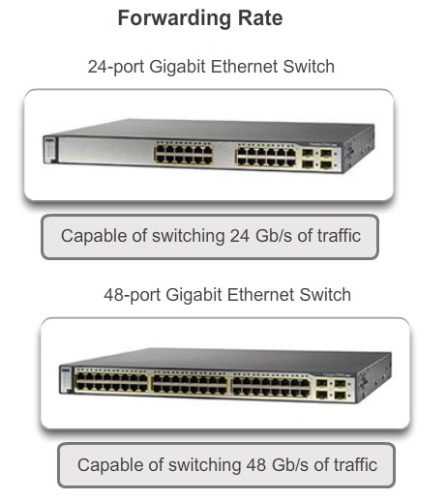
Selecting Network Devices

Slide 38
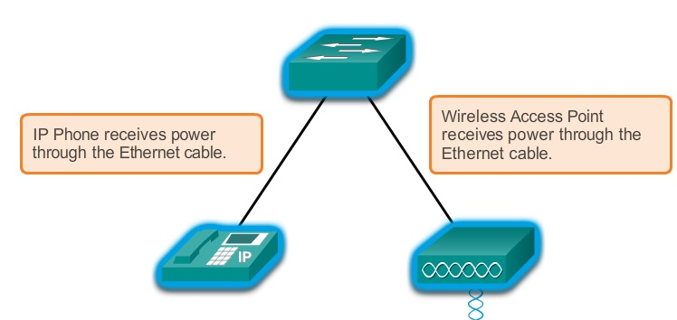
Selecting Network Devices
PoE allows the switch to deliver power to a device over the existing Ethernet cabling. This feature can be used by IP phones and some wireless access points.

Slide 39
Selecting Network Devices
Multilayer switches are typically deployed in the core and distribution layers of an organization's switched network.
Multilayer switches are characterized by their ability to build a routing table, support a few routing protocols, and forward IP packets at a rate close to that of Layer 2 forwarding.

Slide 40
Selecting Network Devices
Routers play a critical role in networking by interconnecting multiple sites within an enterprise network, providing redundant paths, and connecting ISPs on the Internet.
Routers also serve other beneficial functions:
  Provide broadcast containment
  Connect remote locations
  Group users logically by application or department
  Provide enhanced security

Slide 41
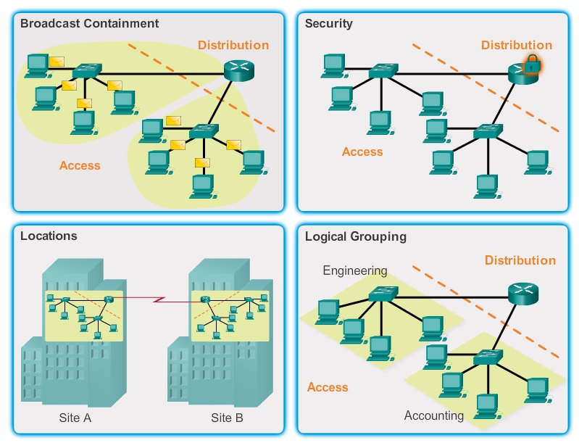
Selecting Network Devices

Slide 42
Selecting Network Devices
Three categories of routers:
  Branch Routers
    Optimize branch services on a single platform while delivering an optimal application experience across branch and WAN infrastructures.
  Network Edge Routers
    Enable the network edge to deliver high-performance, highly secure, and reliable services.
  Service Provider Routers
    Delivering end-to-end scalable solutions and subscriber-aware services.

Slide 43
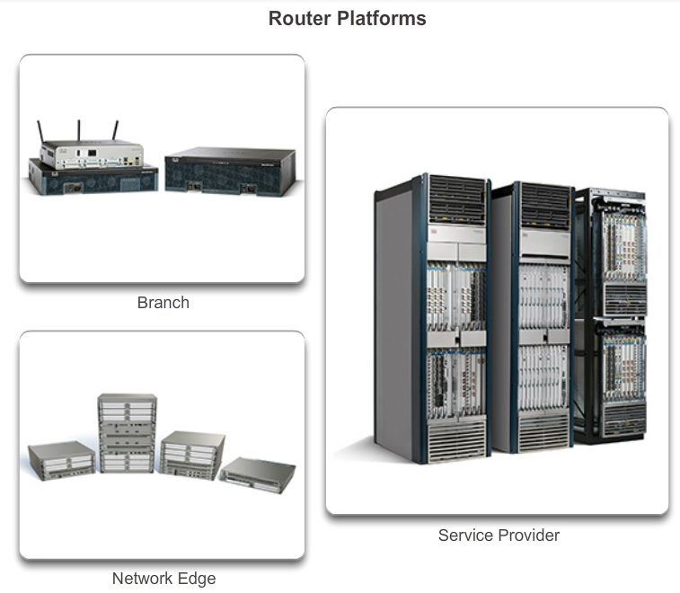
Selecting Network Devices

Slide 44
Selecting Network Devices
Routers can also be categorized as fixed configuration or modular.
With the fixed configuration, the desired router interfaces are built-in.
Modular routers come with multiple slots that allow a network administrator to change the interfaces on the router.

Slide 45
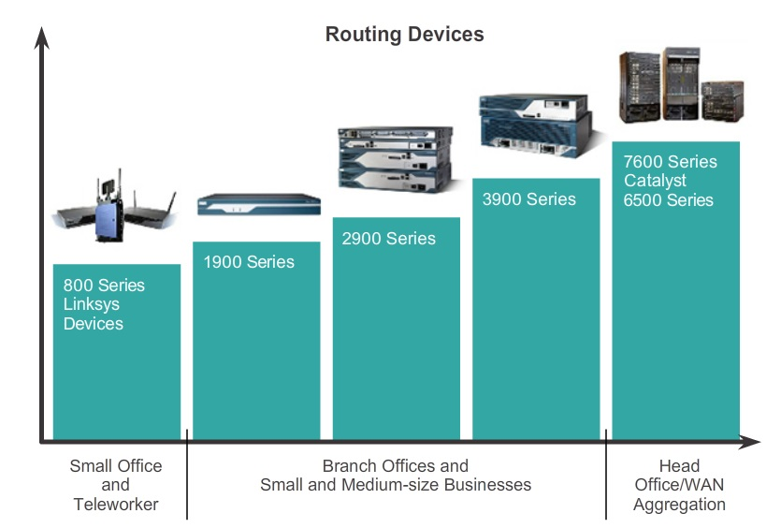
Selecting Network Devices

